Slide 1
Hand Pose Estimation
deyuzhou
2020.08.28

Slide 2
Overview
Hand Pose Estimation: A Survey (2019)
H+O: Unified Egocentric Recognition of 3D Hand-Object Poses and Interactions (2019 CVPR Oral)
FingerTrak: Continuous 3D Hand Pose Tracking by Deep Learning Hand Silhouettes Captured by Miniature Thermal Cameras on Wrist (2020 ECCV)
Summary

Slide 3
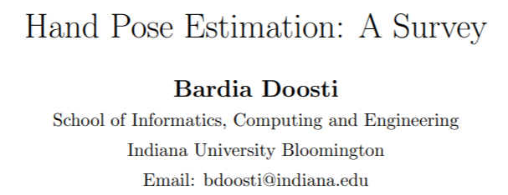

Slide 4
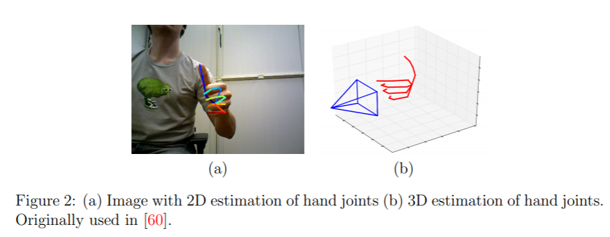
Hand Pose Estimation: A Survey (2019)
Task
2D estimation of hand joints (x, y)
3D estimation of hand joints (x, y, z)

Slide 5
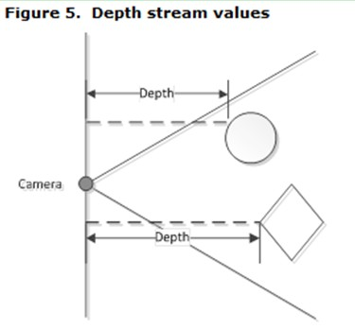
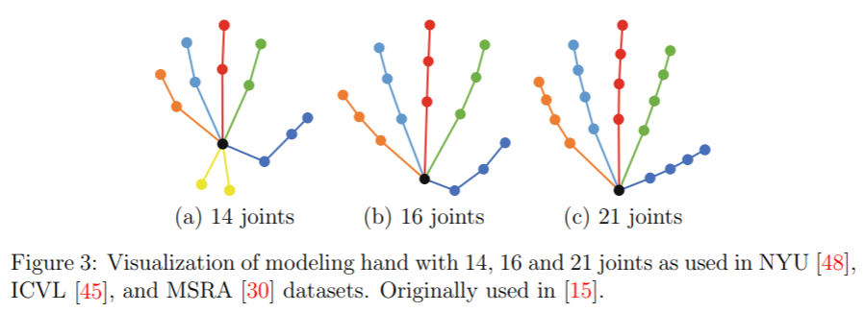
Hand Pose Estimation: A Survey (2019)
Input
RGB Image
Depth Image
RGB + Depth Image
Output
2D estimation
3D estimation

Slide 6
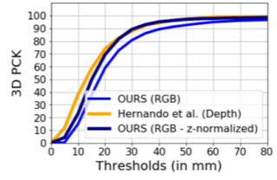
Hand Pose Estimation: A Survey (2019)
Evaluation
Percentage of correct keypoint estimates(3D PCK)

Slide 7
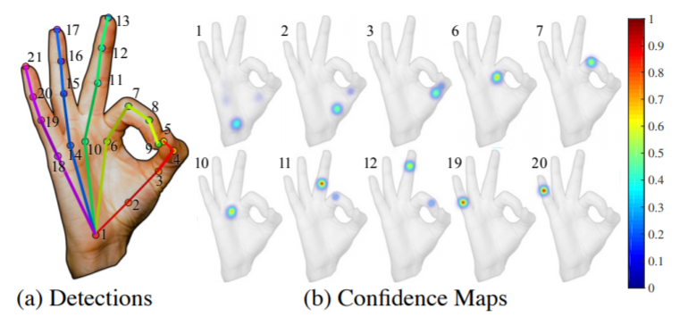
Hand Pose Estimation: A Survey (2019)
Approaches
Traditional
Random Forest
Deep Learning
2D or 3D skeleton
Detection or Regression
Detection: probability density map for each joint
Regression: (x, y, z) coordinates of each joint
2D or 3D CNN
RGB / Depth / RGB + Depth

Slide 8
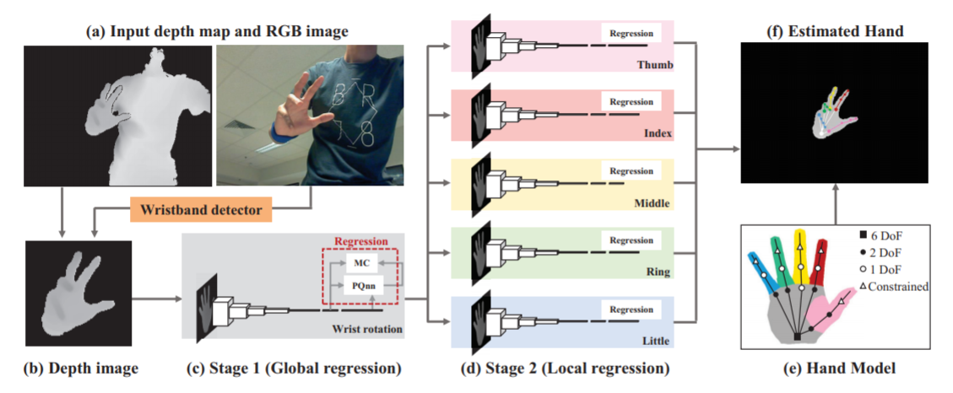
Hand Pose Estimation: A Survey (2019)
Depth-based Approach
Deephand (Sinha et al., CVPR 2016)
A RGB Image for segmentation(RGB skin range) and a depth map for classification
Coordinate values of 21 hand joints
A separate network for each finger to regress three joints on that finger

Slide 9
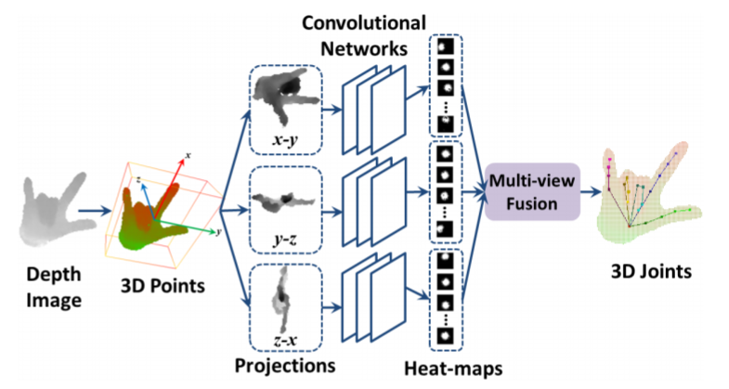
Hand Pose Estimation: A Survey (2019)
Depth-based Approach
Robust 3D HPE in single depth images: from single-view cnn to multi-view CNNs (Ge et al., CVPR 2016)
A depth map of hand
Coordinate values of 21 hand joints
Send 3 perpendicular views of depth map into CNN, get probability of each joint in each xy, xz and yz planes, and fuse them by multiplying them

Slide 10
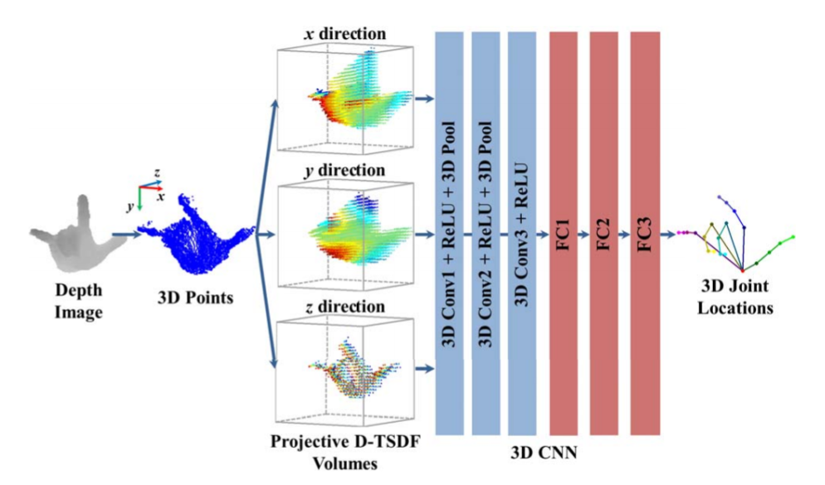
Hand Pose Estimation: A Survey (2019)
Depth-based Approach
3D CNNs for efficient and robust HPE from single depth images (Ge et al., CVPR 2017)
A depth map of hand
Coordinate values of 21 hand joints
Send 3 generated 3D shapes, 3D CNNs, concat the output vectors to FC and get the result

Slide 11
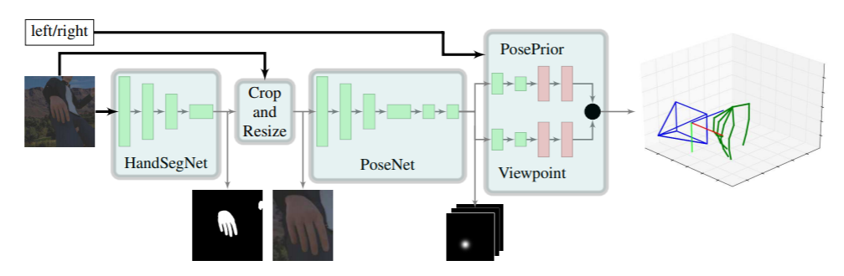
Hand Pose Estimation: A Survey (2019)
RGB-based Approach
Learning to estimate 3d hand pose from single rgb images (Wei et al., ICCV 2017)
An RGB image
Coordinate values of 21 hand joints
HandSegNet to seg hand, PoseNet predicts heatmap for each hand joint, PosePrior(regression) transform 2D to 3D

Slide 12
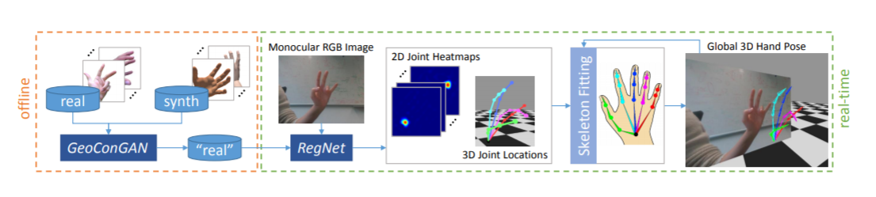
Hand Pose Estimation: A Survey (2019)
RGB-based Approach
GANerated Hands for Real-Time 3D Hand Tracking from Monocular RGB (Mueller et al., CVPR 2018)
An RGB image
Coordinate values of 21 hand joints
Cycle Gan, Data augmentation

Slide 13
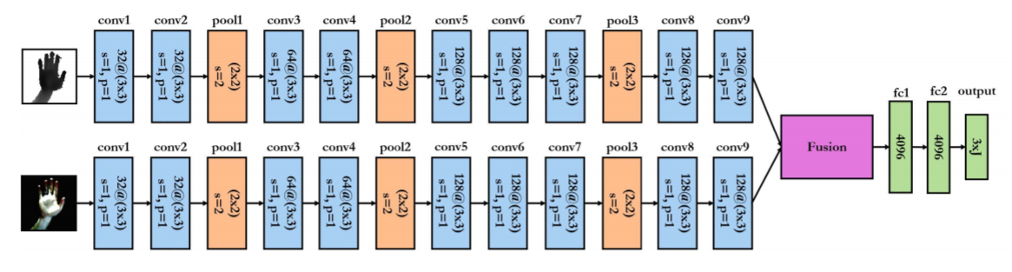
Hand Pose Estimation: A Survey (2019)
RGBD-based Approach
On the fusion of rgb and depth information for hand pose estimation. (Kazakos et al., ICIP 2018)
An RGB and a depth images
Coordinate values of 21 hand joints
2-way CNN and fusion for regression

Slide 14
Hand Pose Estimation: A Survey (2019)
Summarization
Depth-based
Input
Single/Multiple
2D/3D
Architecture
2D/3D CNN
Cycle GAN
Prediction
Detection/Regression -> Fusion
Fusion -> Detection/Regression

Slide 15
Hand Pose Estimation: A Survey (2019)
Summarization
RGB-based
Segmentation
RGB range of skin
SegNet
Architecture
Cycle GAN
2D CNN
2-way fusion

Slide 16
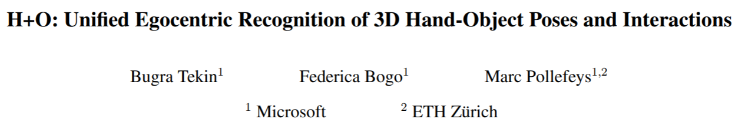

Slide 17
H+O (CVPR 2019 Oral)
Motivation
Few research focuses on joint visual understanding of humans and objects
Propose a unified method to jointly recognize 3D hand and object poses, and their interactions from egocentric RGB images
Task
Input
RGB image(s)
Output
3D hand poses
3D object poses
Object classes
Action classes

Slide 18
H+O (CVPR 2019 Oral)
Previous Works
Rely on active depth sensors or multi-camera systems
Careless about action
Without recovering the object pose in 3D
Contributions
Unified framework (multi-task)
Single-shot (simple)
Temporally model interactions (extension for vedios)

Slide 19
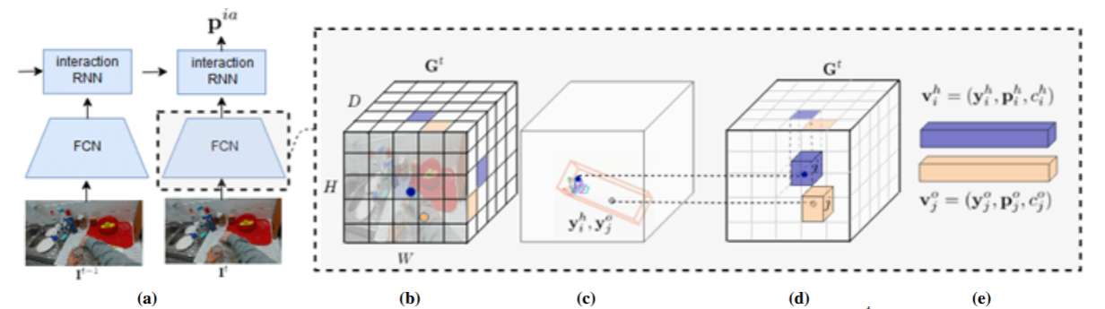
H+O (CVPR 2019 Oral)

Slide 20
H+O (CVPR 2019 Oral)
Grid(G)
Size
(H, W, D)
Content
Hand pose vector (N_hp, 3)
Hand pose confidence (1)
Action class probabilities (N_ac)
Object pose vector (N_op, 3)
Object pose confidence (1)
Object class probabilities (N_oc)

Slide 21
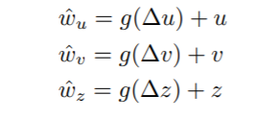
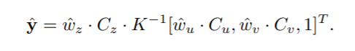
H+O (CVPR 2019 Oral)
Training
Similar to YOLOv2 (Redmon et al., CVPR 2017)
Position Prediction
For hand root joint and object centroid, offset lies between 0 and 1 (sigmoid)
Object Pose Prediction
Align the prediction to the reference 3D bounding box with a rigid transformation*

Slide 22
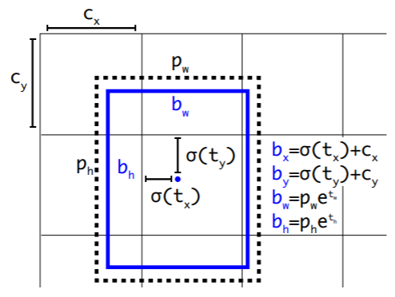
YOLOv2

Slide 23
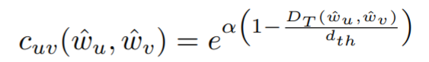
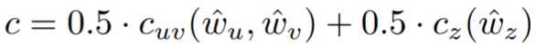
H+O (CVPR 2019 Oral)
Training
Confidence Definition
Euclidean Distance
Why don't you directly compute 3D distance in the first term?

Slide 24
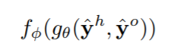
H+O (CVPR 2019 Oral)
Training
Object and Action Recognition
Action class
Verb
Object class
Noun
Interaction
Verb + noun
Need LSTM to recongize complex actions
y_hand
y_object
MLP*

Slide 25
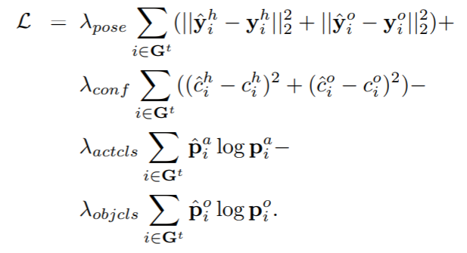
H+O (CVPR 2019 Oral)
Training
Loss function
Coef of confidence
5 and 0.1* (stability)
2-stage training

Slide 26
H+O (CVPR 2019 Oral)
Data
Dataset
First-Person Hand Action (FPHA-HO) (?)
It is the only publicly available dataset for 3D hand-object interaction recognition that contains labels for 3D hand pose, 6D object pose and action categories.
SynthHands 3D hand pose estimation dataset (train)
Randomly superimposing on the image synthetic cuboid objects that we generate and object segmentation masks from the third-person view dataset of [60] which features the same object
Replace the backgrounds using random images
Annotates a EgoDexter hand pose estimation dataset (valid)
Annotates the Desk sequence between frames 350 and 500 which features a cuboid object (test?)
Data Augmentation
randomly change the hue, saturation and exposure of the image by up to a factor of 50%. We also randomly translate the image by up to a factor of 10%.

Slide 27
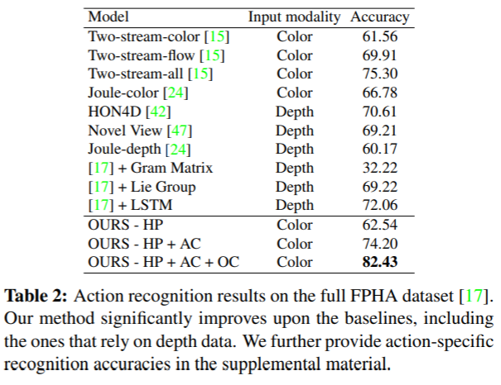
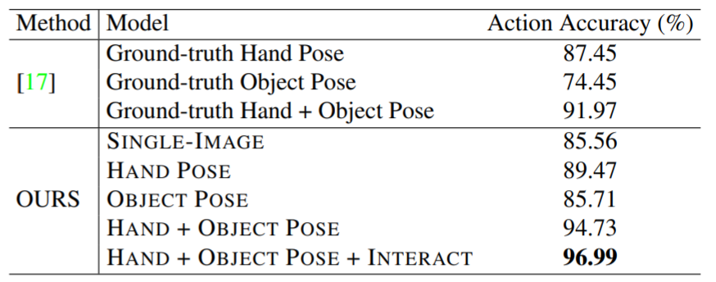
H+O (CVPR 2019 Oral)
Result
Action recognition

Slide 28
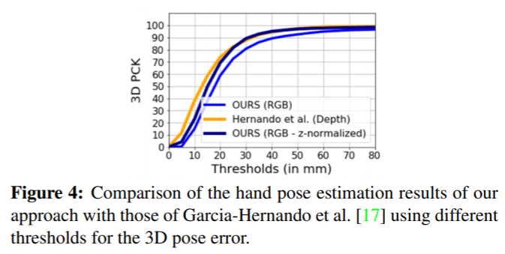
H+O (CVPR 2019 Oral)
Result
Hand pose estimation

Slide 29
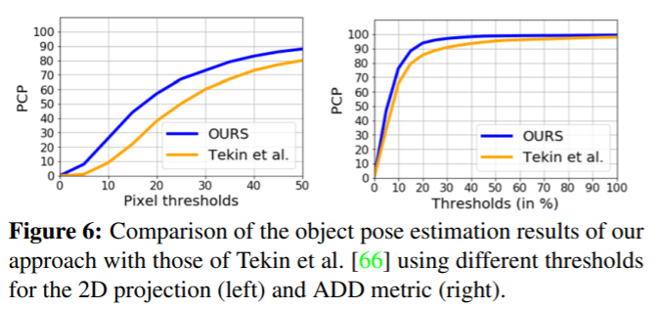
H+O (CVPR 2019 Oral)
Result
Object 6D pose estimation

Slide 30
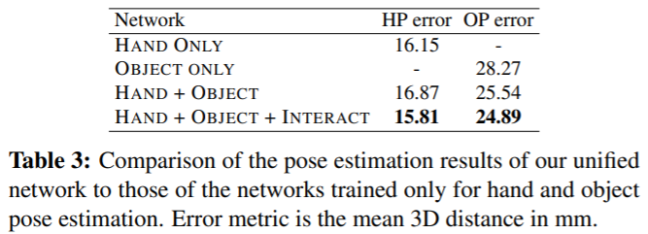
H+O (CVPR 2019 Oral)
Result
Unified Framework

Slide 31
H+O (CVPR 2019 Oral)
Result
Runtime
25 fps on a Tesla M40
33 fps only pose

Slide 32
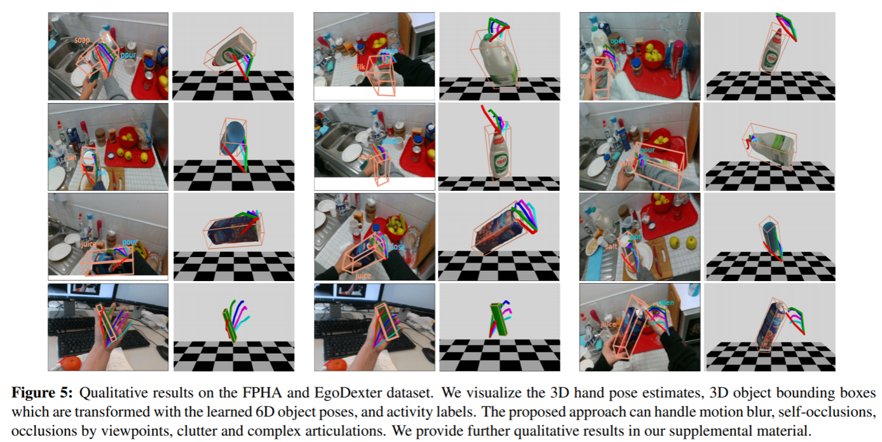
H+O (CVPR 2019 Oral)
Visulization

Slide 33
H+O (CVPR 2019 Oral)
Rethinking
Why do they use YOLOv2 backbone?
CPM
Hourglass
Why not use sequential module before pose estimation?
Hand
Object

Slide 34
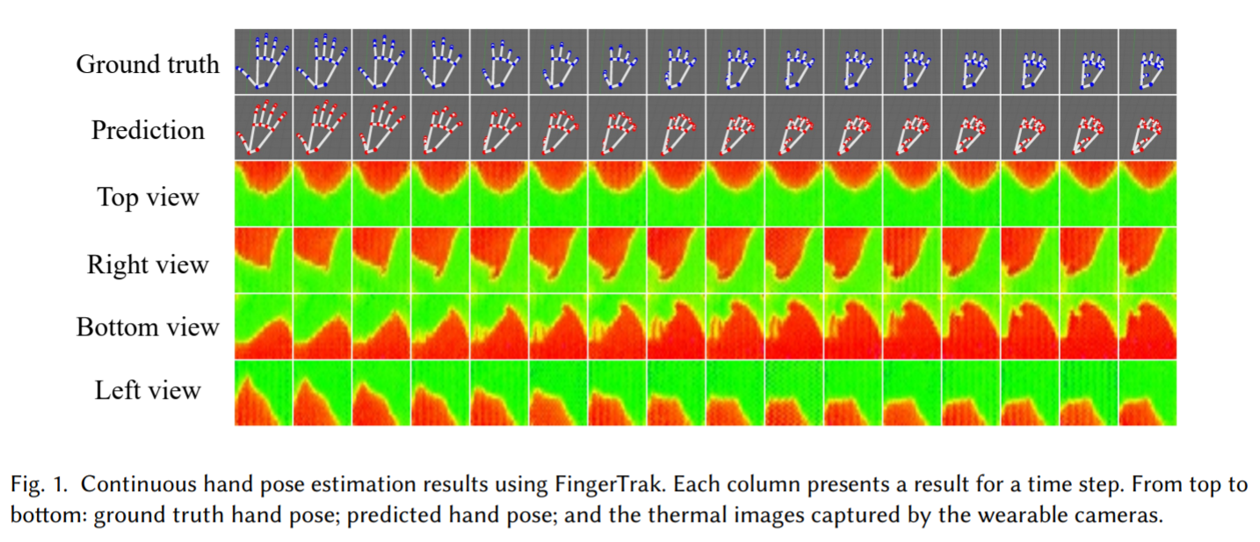
FingerTrak (ECCV 2020)
Motivation
Can we estimate the entire hand posture by observing only the outline of the hand?

Slide 35
FingerTrak (ECCV 2020)
Task
Input
Outline of hand (RGB images)
Output
3D hand poses
Verification
Generate Synthetic Multi-view Hand Silhouettes
Hand model (MANO)
Gaussian distribution
n virtual cameras

Slide 36
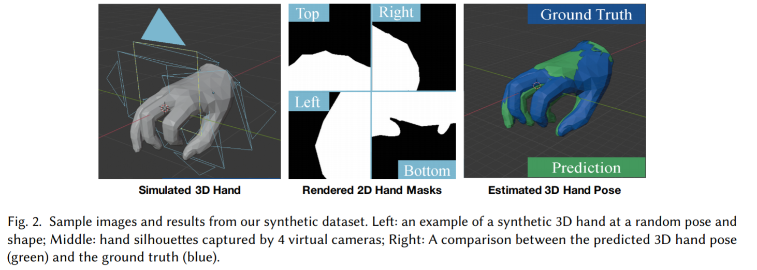
FingerTrak (ECCV 2020)

Slide 37
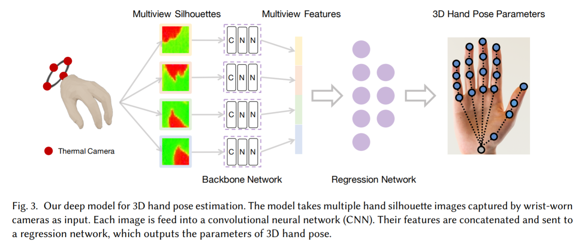
FingerTrak (ECCV 2020)
Model

Slide 38
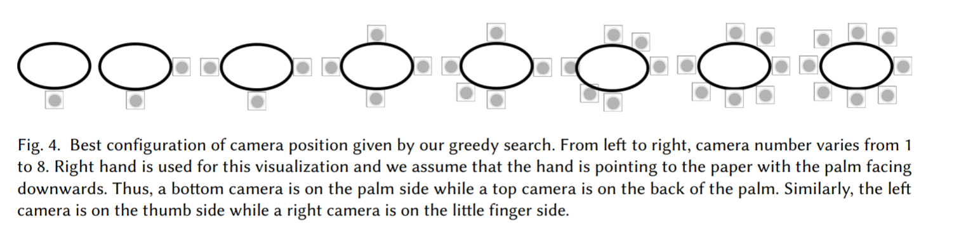
FingerTrak (ECCV 2020)
How to decide the number of camera?

Slide 39
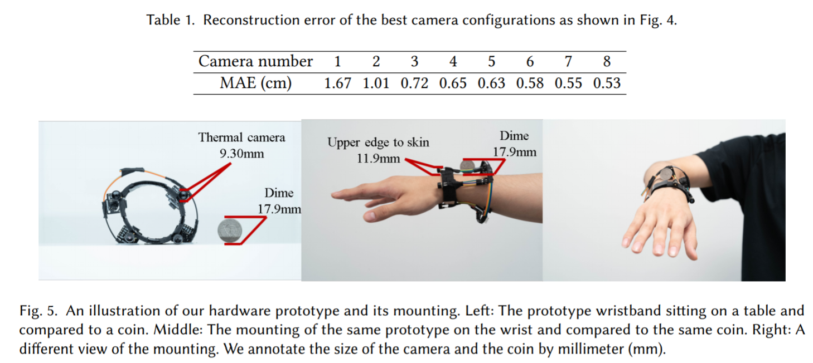
FingerTrak (ECCV 2020)

Slide 40
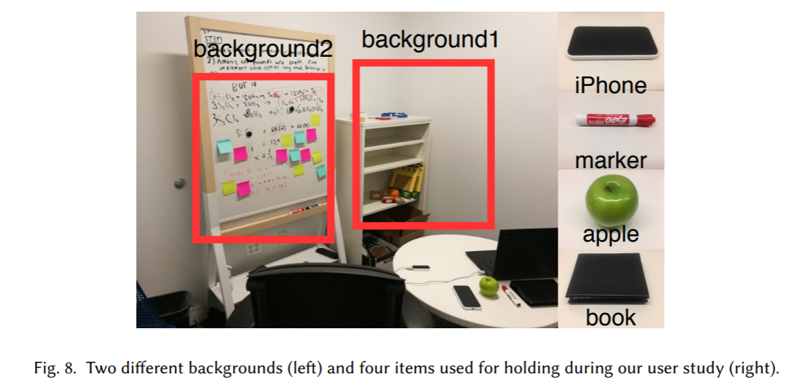
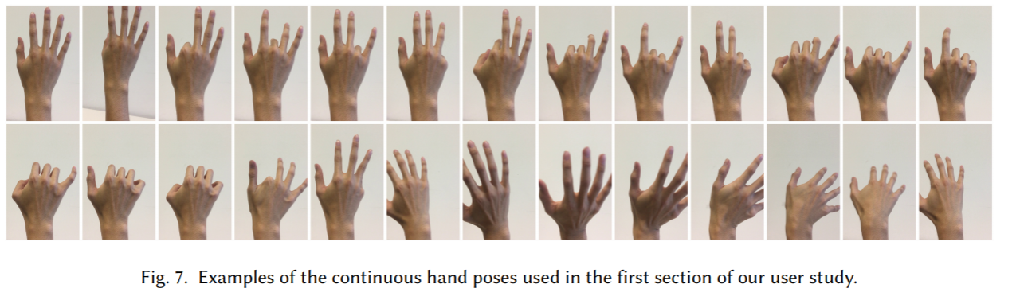
FingerTrak (ECCV 2020)
Real Data

Slide 41
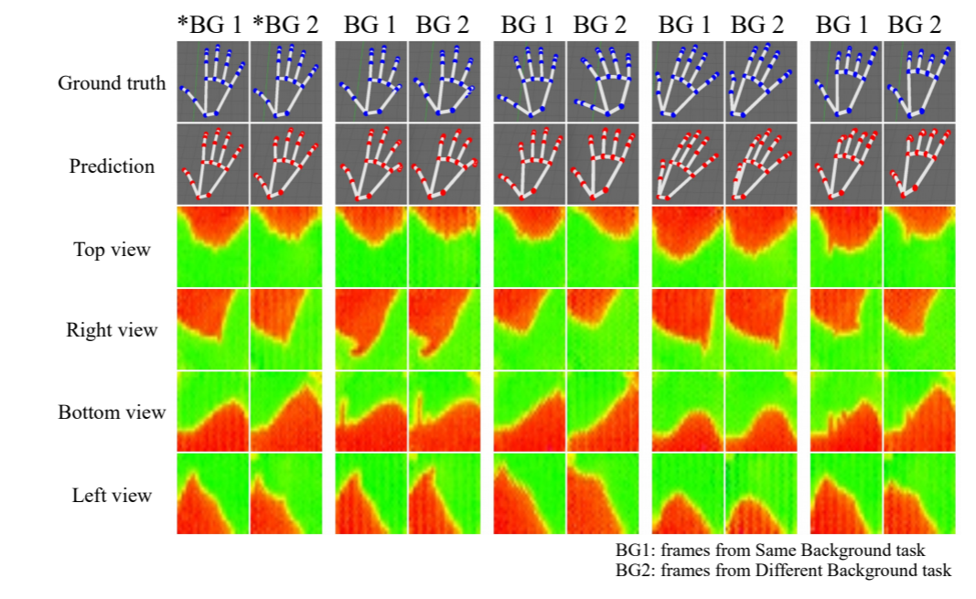
FingerTrak (ECCV 2020)
Visulization

Slide 42
FingerTrak (ECCV 2020)
Rethinking
Verification of ideas

Slide 43
Summary
Problems
Self-occlusion
Hard to solve (human)
Data not enough
Hand with object
Multi hands
Data unavailable

